Slide 1
BATTERY THERMAL MANAGEMENT USING HEAT PIPE INTEGRATED PELTIER COOLING SYSTEM

Slide 2
Details
Team Lead: ADHITYA LS
Team Members: ARUVI B
ARAVINDH R
KARTHIK S
SANTHOSH SINGH R
Technology Readiness Level: TRL --03
Team Mentor with Designation and Department:
Dr. P. C.MURUGAN/Associate Professor,
Mr. K.Nithyanandhan / Assistant Professor
Department of Automobile Engineering,
Kongu Engineering College, Perundurai

Slide 3

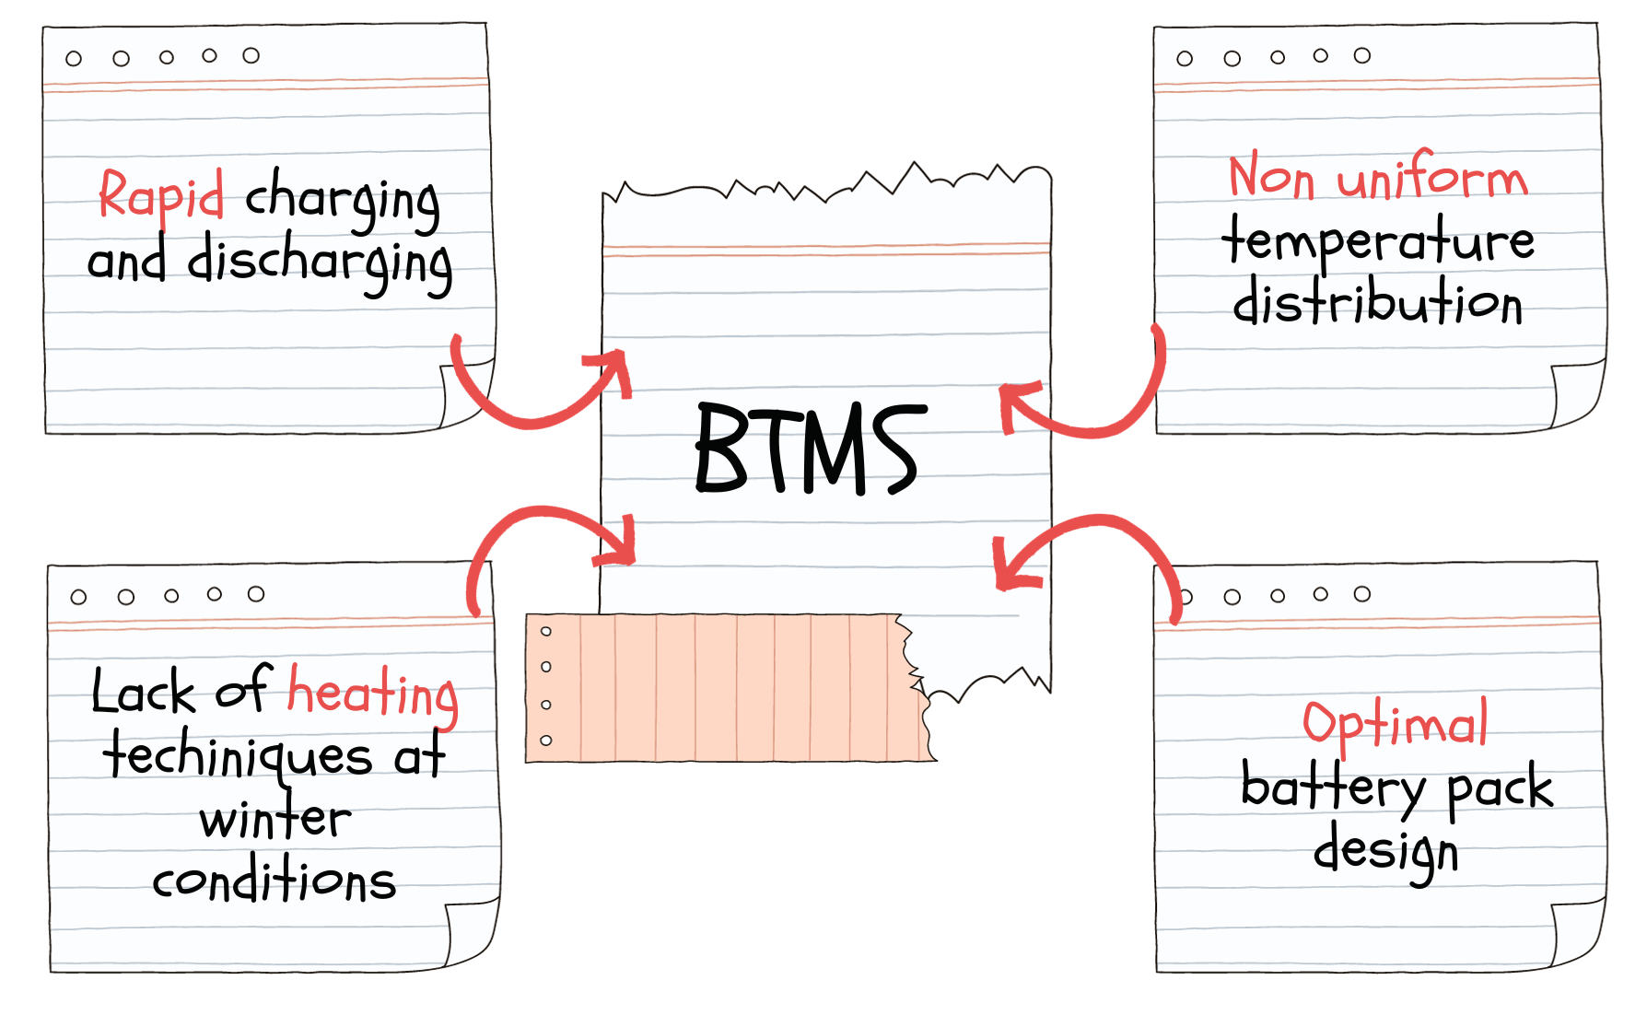
PROBLEM STATEMENT
2

Slide 4
THE SOLUTION
EV Battery Thermal Management system using Peltier Module
System specialized for precise maintenance of battery pack optimal temperature
Using peltier module to maintain EV battery pack optimal temperature range
Dielectric fluid immersion cooling is employed
Heat dissipation from peltier chip is done via heat pipe assisted heatsink fitted with blowers

Slide 5
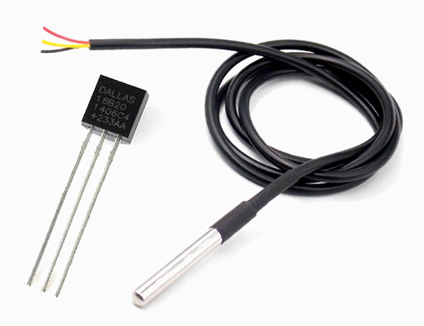
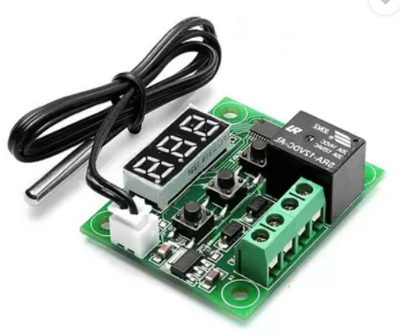

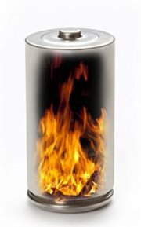
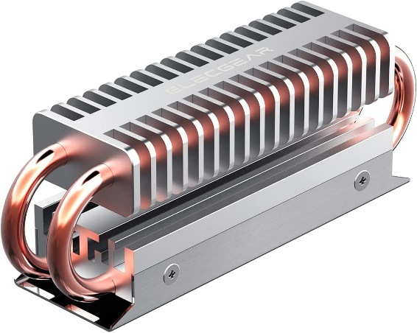
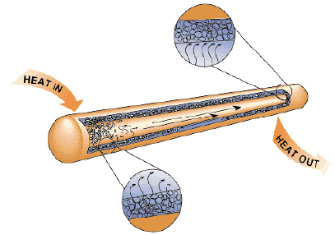
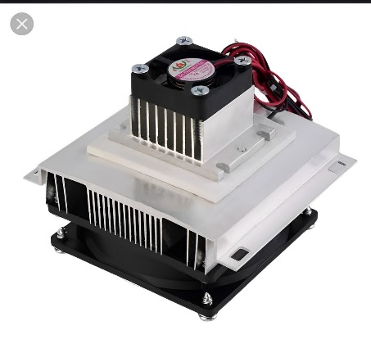

Solution
Temperature Sensor
Control Module
Heat Removed From Battery Pack
Cell
Heat
Control Module
Heat From the Cell
Result
Result
Heat Pipe Integrated System
Heat Pipe
Peltier cooling system
Heat Pipe

Slide 6
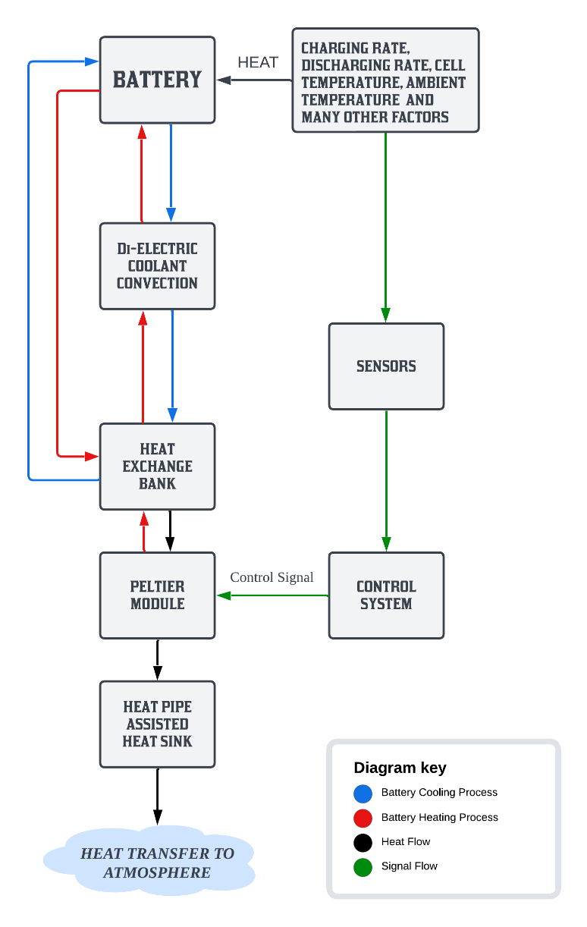
Flowchart/ Product workflow

Slide 7
Customer Segment
Who is facing the problem that you are solving?
EV owners
Who is your target customer / Sector?
EV battery pack manufacturers
What type of business is it?
B2B

Slide 8
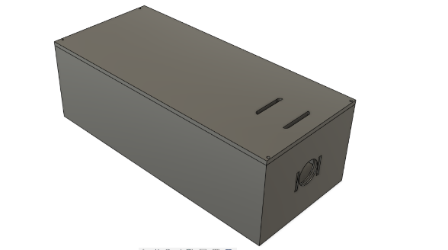
Idea - Current Status / Future Plan Timeline & Milestones
Testing and validation
Prototyping
Design finalization
Optimizing BTMS performance
Mathematical model development in SIMULINK, MATLAB
Final product

Slide 9
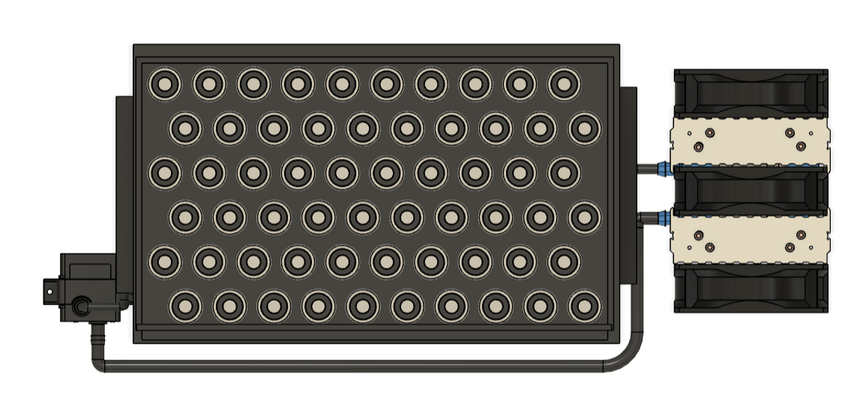
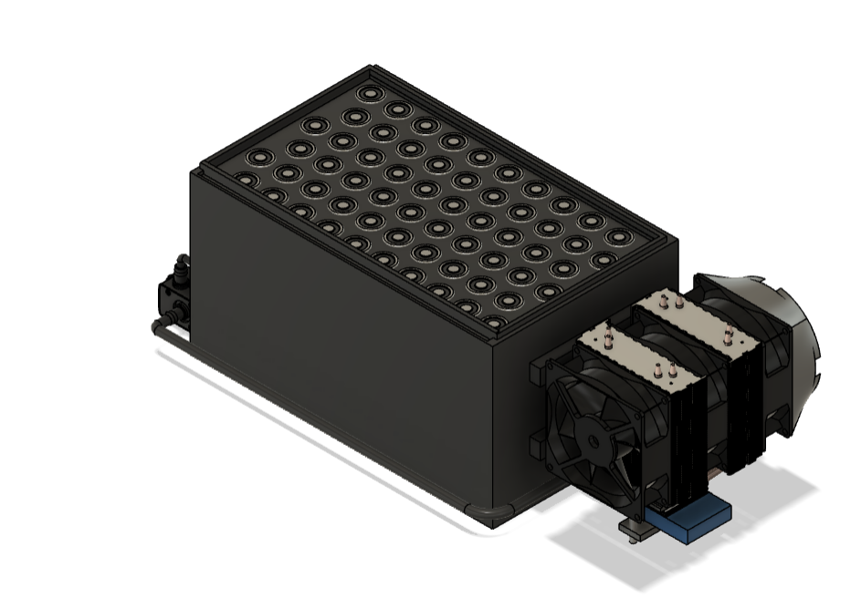
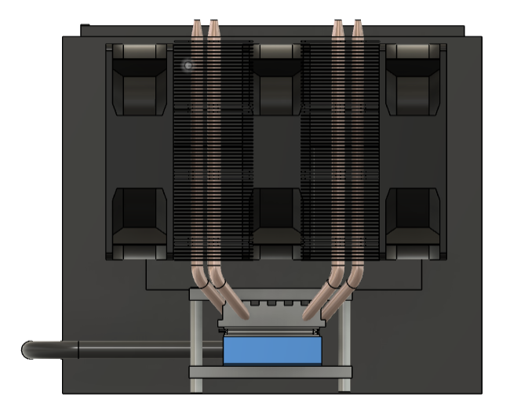
Prototype CAD model
Top View
Isometric View
Front View

Slide 10
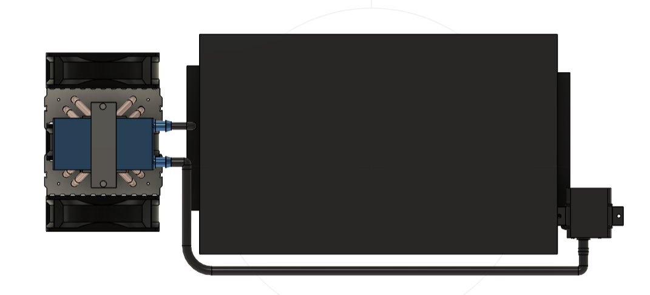
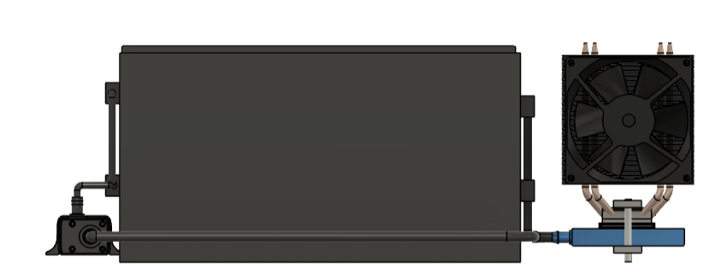
Side Views

Slide 11
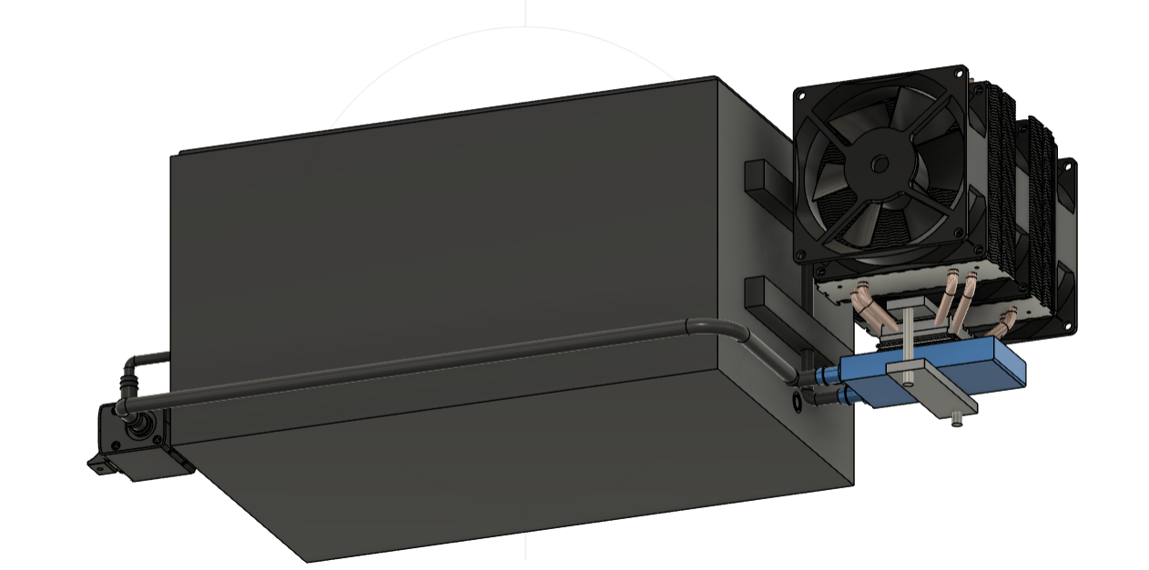
Bottom Side View

Slide 12
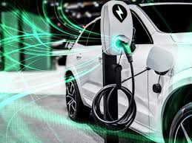


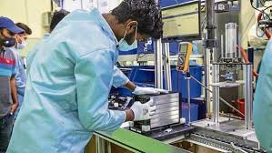


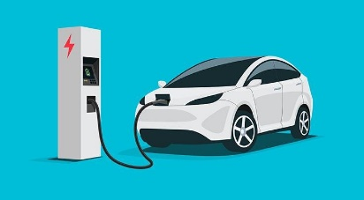
Customer Segment
Battery Manufacturers, Electric Vehicle (EV) manufacturers, Renewable Energy System providers, and any industry relying on high-performance Batteries.
Indian targeted EV manufacturers
Battery Manufacturers

Slide 13
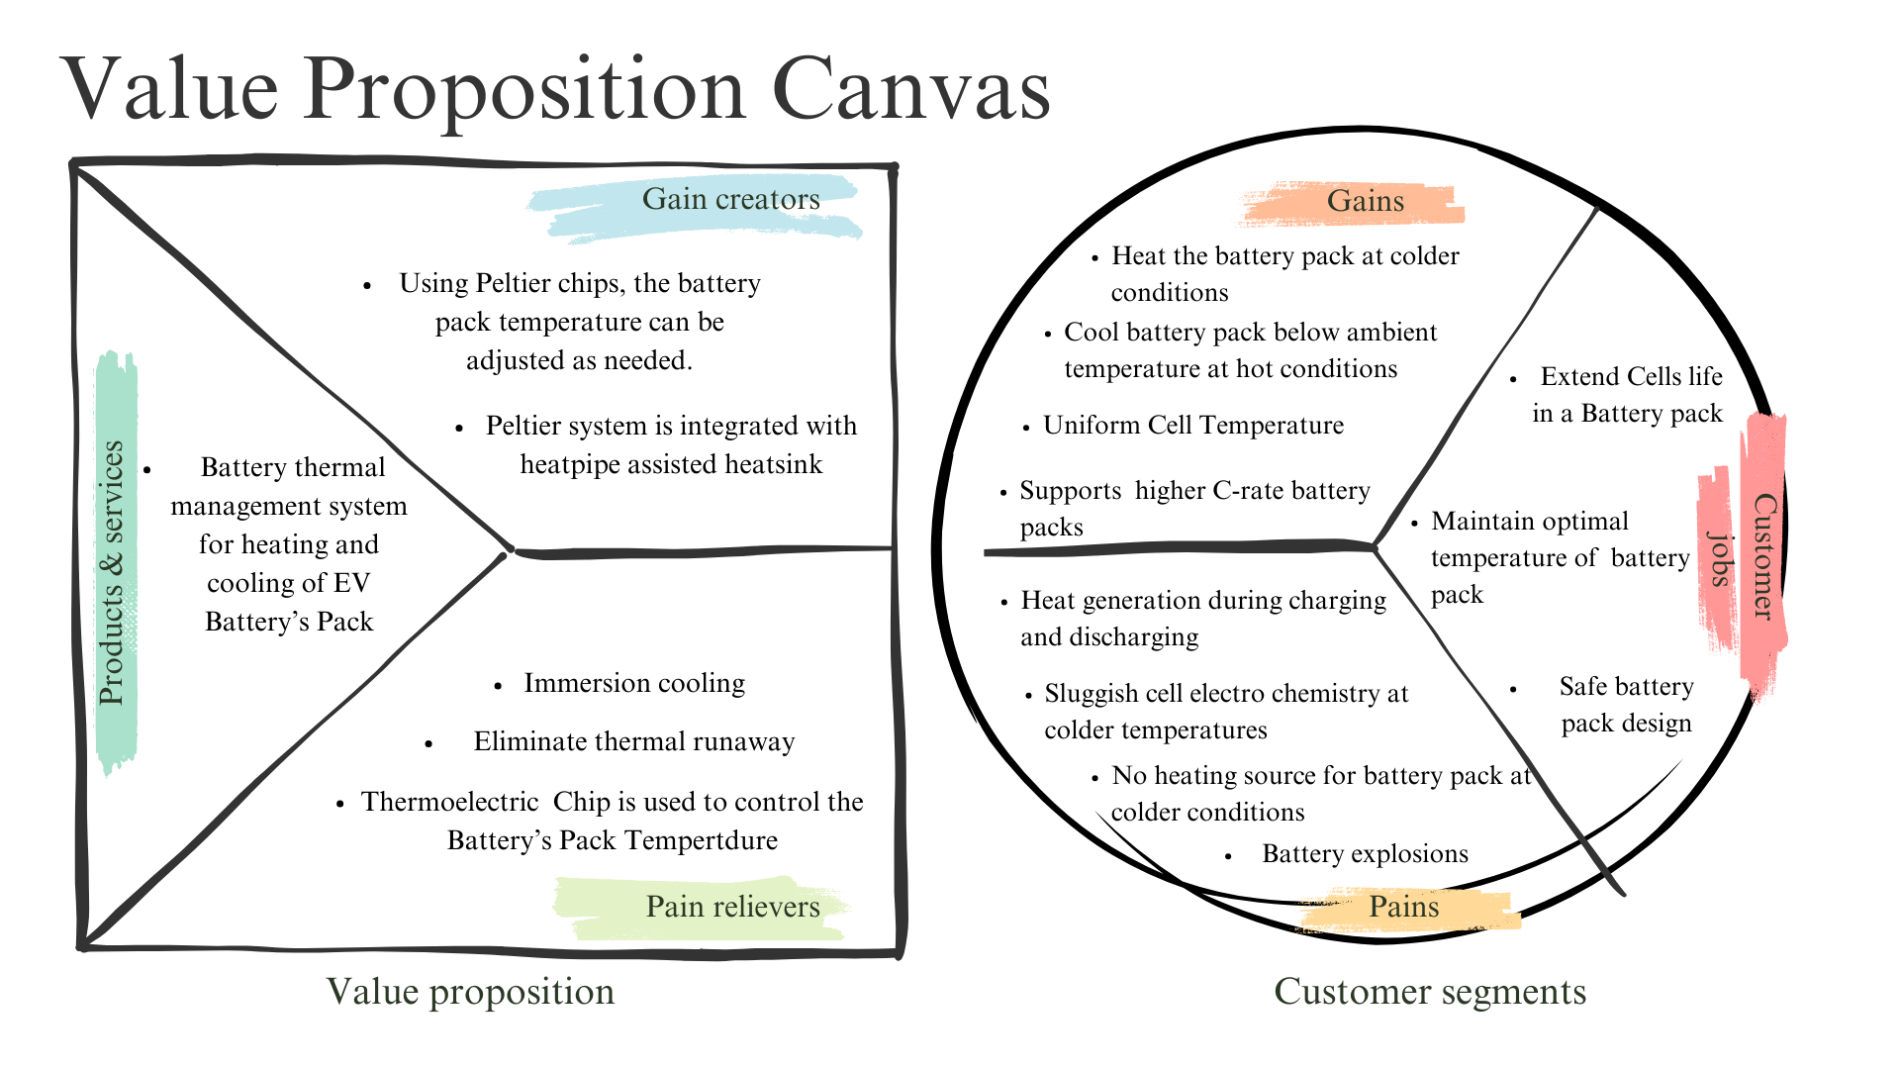

Slide 14
Channels (Marketing)
How will you reach your customers in a cost-effective manner?
Auto shows
Stalls in Startup Events
What marketing method will you do to get customers?
Partnerships and Collaborations
Industry Events and Conferences

Slide 15
Competitors
Is any company already working on your idea?
Currently, there are no direct competitors as other companies are focused on BTMS within the context of battery pack subdivisions, and as of now, no separate company has been established in this specific area.

Slide 16
Revenue Model
How do you plan to make money?
Product Sales
Government Grants and Subsidies
Licensing and Royalties

Slide 17
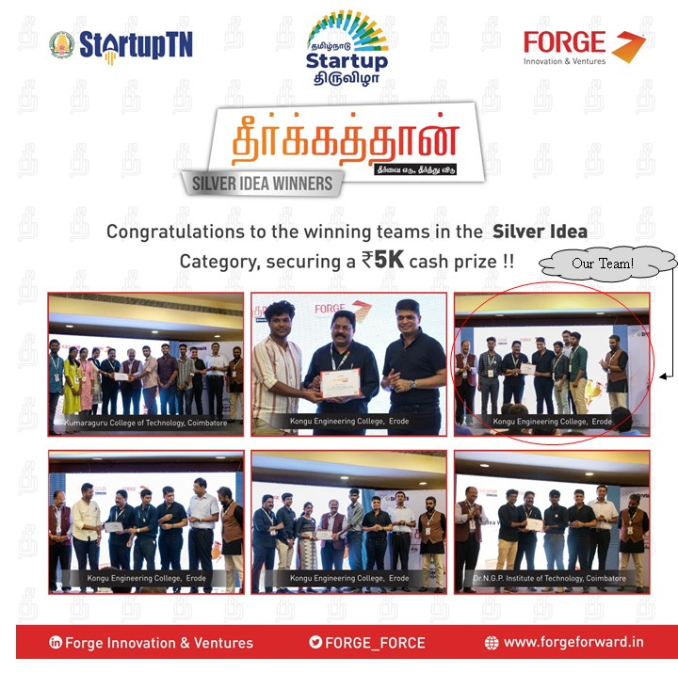
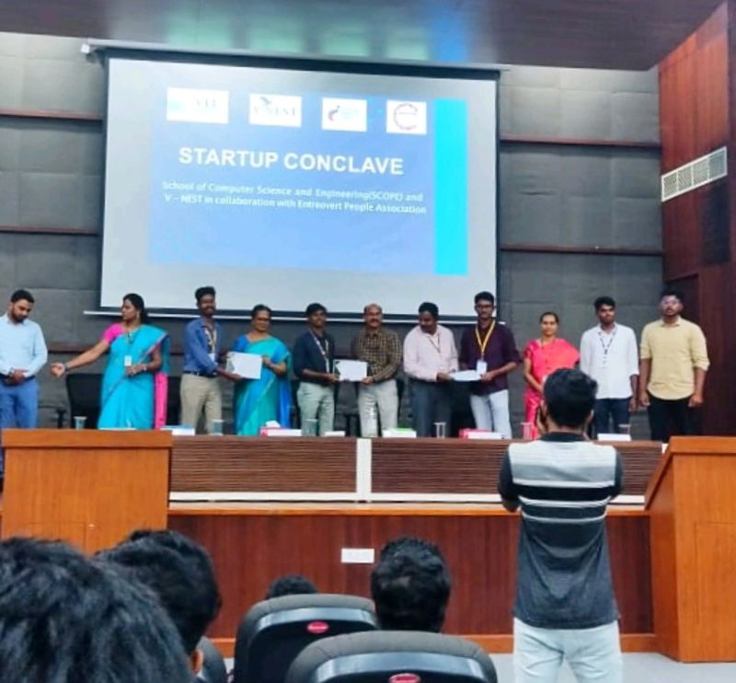
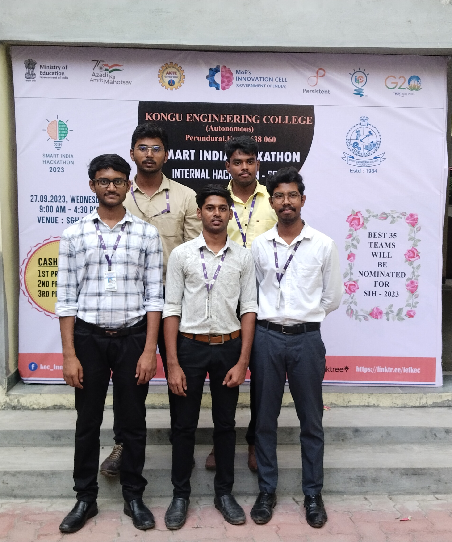
Have you got any awards / recognition ?
WON SILVER AWARD IN STARTUP TN
WON FIRST PRIZE IN VIT STARTUP CONCLAVE
WON SECOND PRIZE IN INTERNAL SMART INDIA HACKATHON

Slide 18
Have you got any other funding support?
RECEIVED SPARK FUNDING VIA TBI@KEC
Rs. 34,500/-
RECEIVED CASH PRIZE IN VIT STARTUP CONCLAVE
Rs. 15,000/-
RECEIVED CASH PRIZE IN THEERKATHAN AT STARTUP TN
Rs. 5,000/-
RECEIVED CASH PRIZE IN SIH INTERNAL HACKATHON(2023) AT OUR COLLEGE
Rs. 1,500/-
Currently having fund of ₹56,000/-

